Slide 1
Using Mantid with muon experiments, instruments and data
James Lord and Anthony Lim

Slide 2
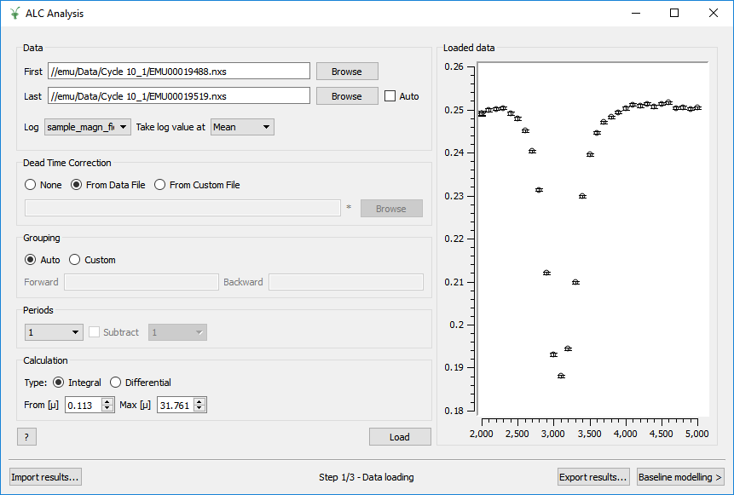
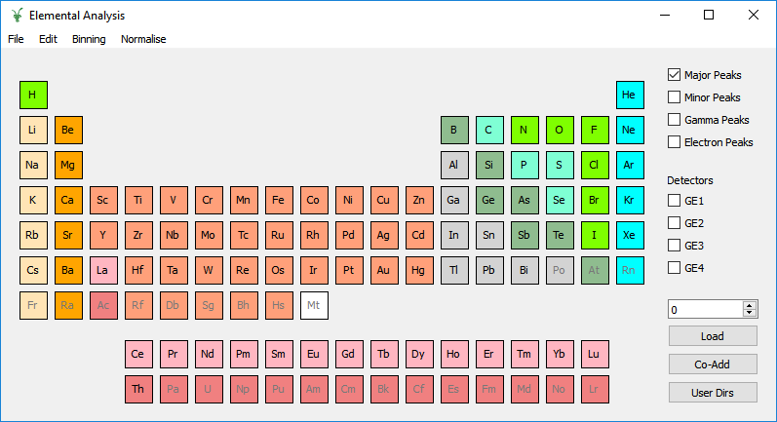
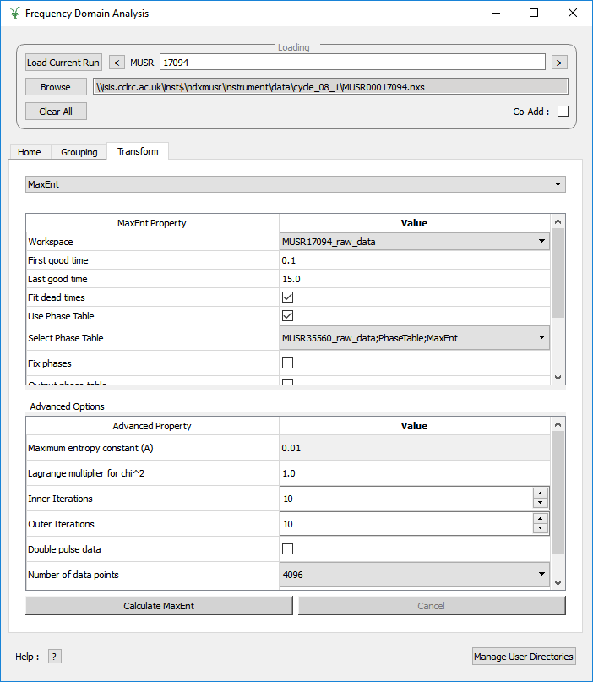
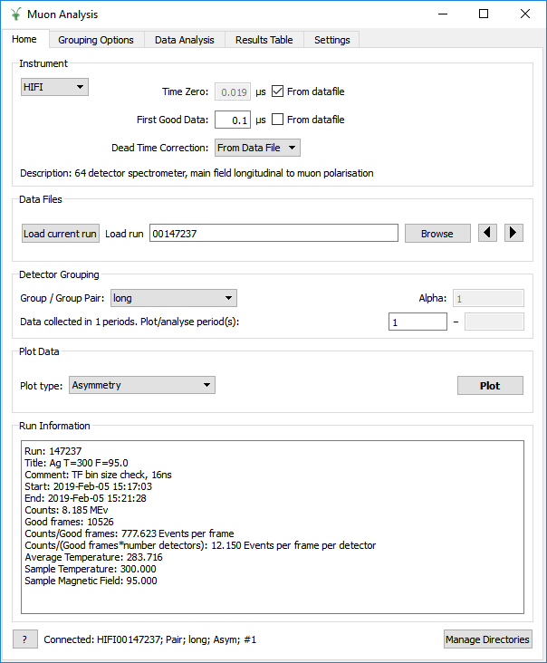
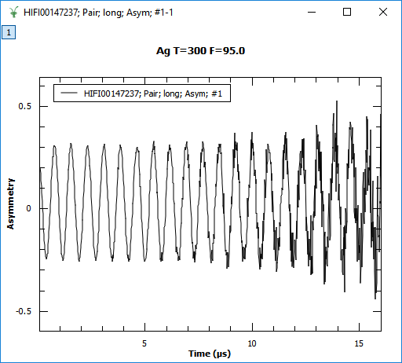
Muon interfaces

Slide 3
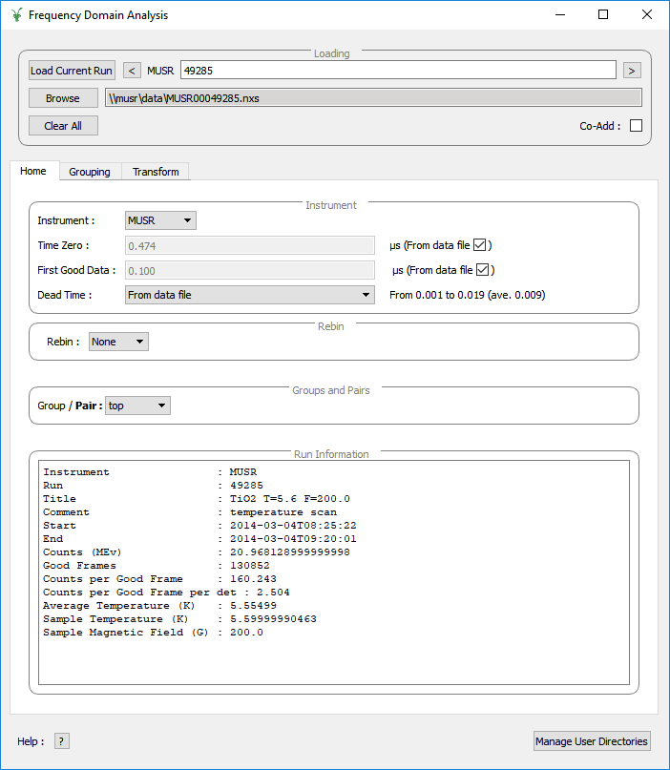
Frequency Domain
Muons precess in a magnetic field
Oscillation in spectra
Internal fields in magnets and superconductors
Hyperfine coupling of muonium in semiconductors
Example here: TiO2 crystal, with TF 200G

Slide 4
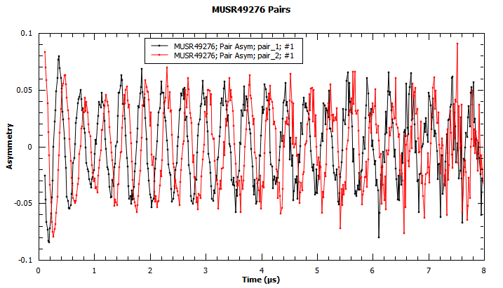
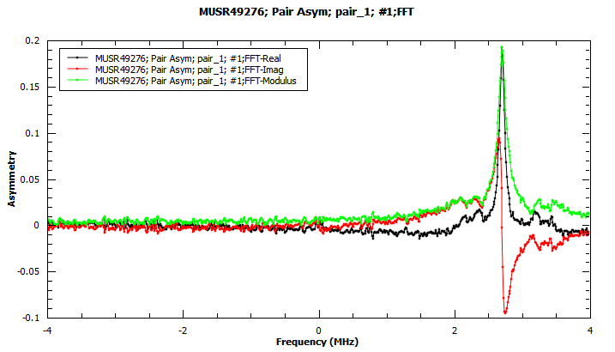
FFT
Group data, or use PhaseQuad
Transform.
TF data:
Complex inputs
Peaks give sign of local fields
LF data:
Only F-B asymmetry
Unsigned |B|

Slide 5
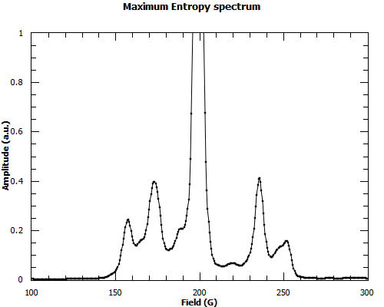
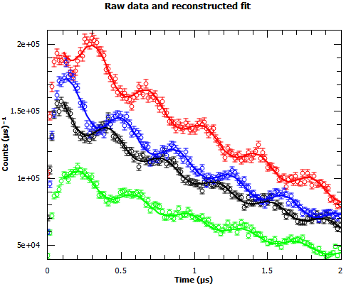
Maximum Entropy
Best Fit of a spectrum to reconstruct the data
Muon version
One spectrum for the whole run
Detectors have their own phases and amplitudes
Optimise the resolution and signal-to-noise

Slide 6
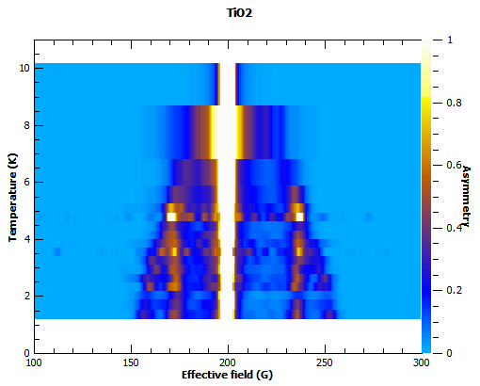
2D plot
ConjoinSpectra to get 2D plot of intensity vs. field and temperature
Splitting of sidebands clearly visible

Slide 7
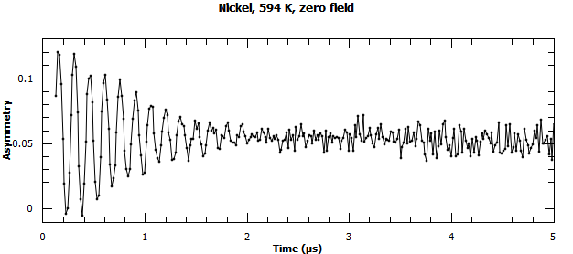
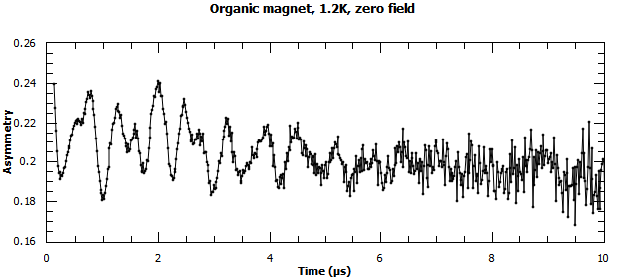
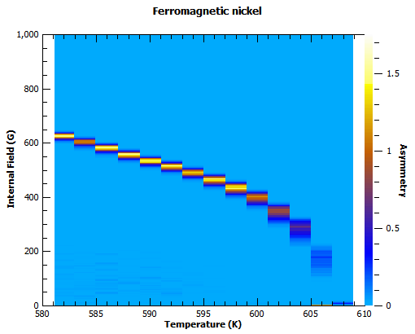
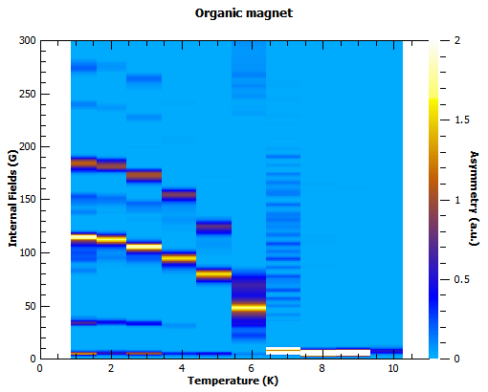
Magnetism
Ideal case: one frequency
Easy to fit in time domain
Real life: complex structure
Frequency domain helps

Slide 8
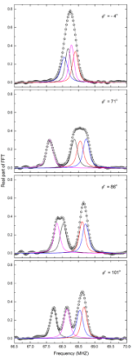
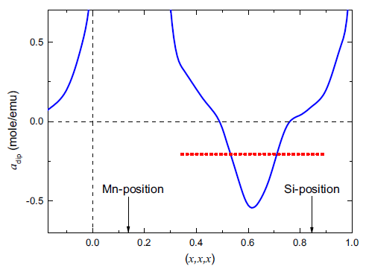
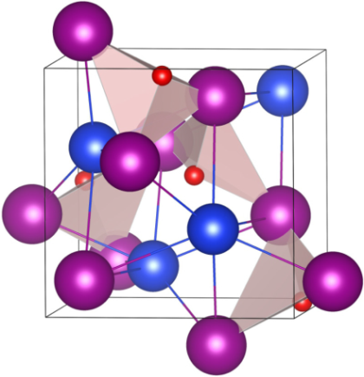
Simulation supporting Analysis …
Knowledge of the muon site often key to detailed interpretation
Calculation package (MuESR) developed to predict muon sites
Python library running under Mantid
Being developed as part of the EU funded SINE2020 project
MnSi;
‘red’ – µ⁺
Measurements
+
Calculations
→
Site prediction / Interpretation
Example from A. Amato et al, PRB 89, 184425 (2014)

Slide 9
Simulations
QUANTUM program to model muon spins interacting with sample
Originally stand alone FORTRAN .exe
Inputs from dialog boxes
Output to files, plot in another package
Rewritten in Python using NumPy
Mantid algorithm
Input table to define model (flexible)
Save / load / edit tables or create from script
Output to Workspaces
In the Script Repository

Slide 10
Simulation and Fitting
QUANTUM simulation also works as a fit function
Use within Muon Analysis, Muon ALC or a script
Vary model parameters to optimise fit
Simultaneous model/fit at several magnetic fields or temperatures
Model parameters tied together
Field inputs set from log values

Slide 11
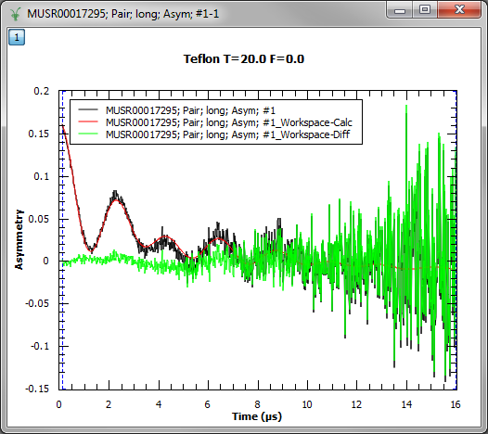
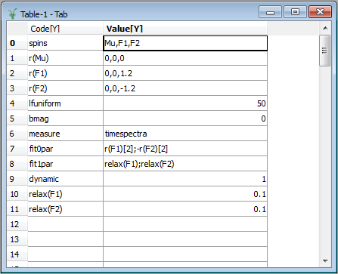
QUANTUM example
Data and fit
Model definition table

Slide 12
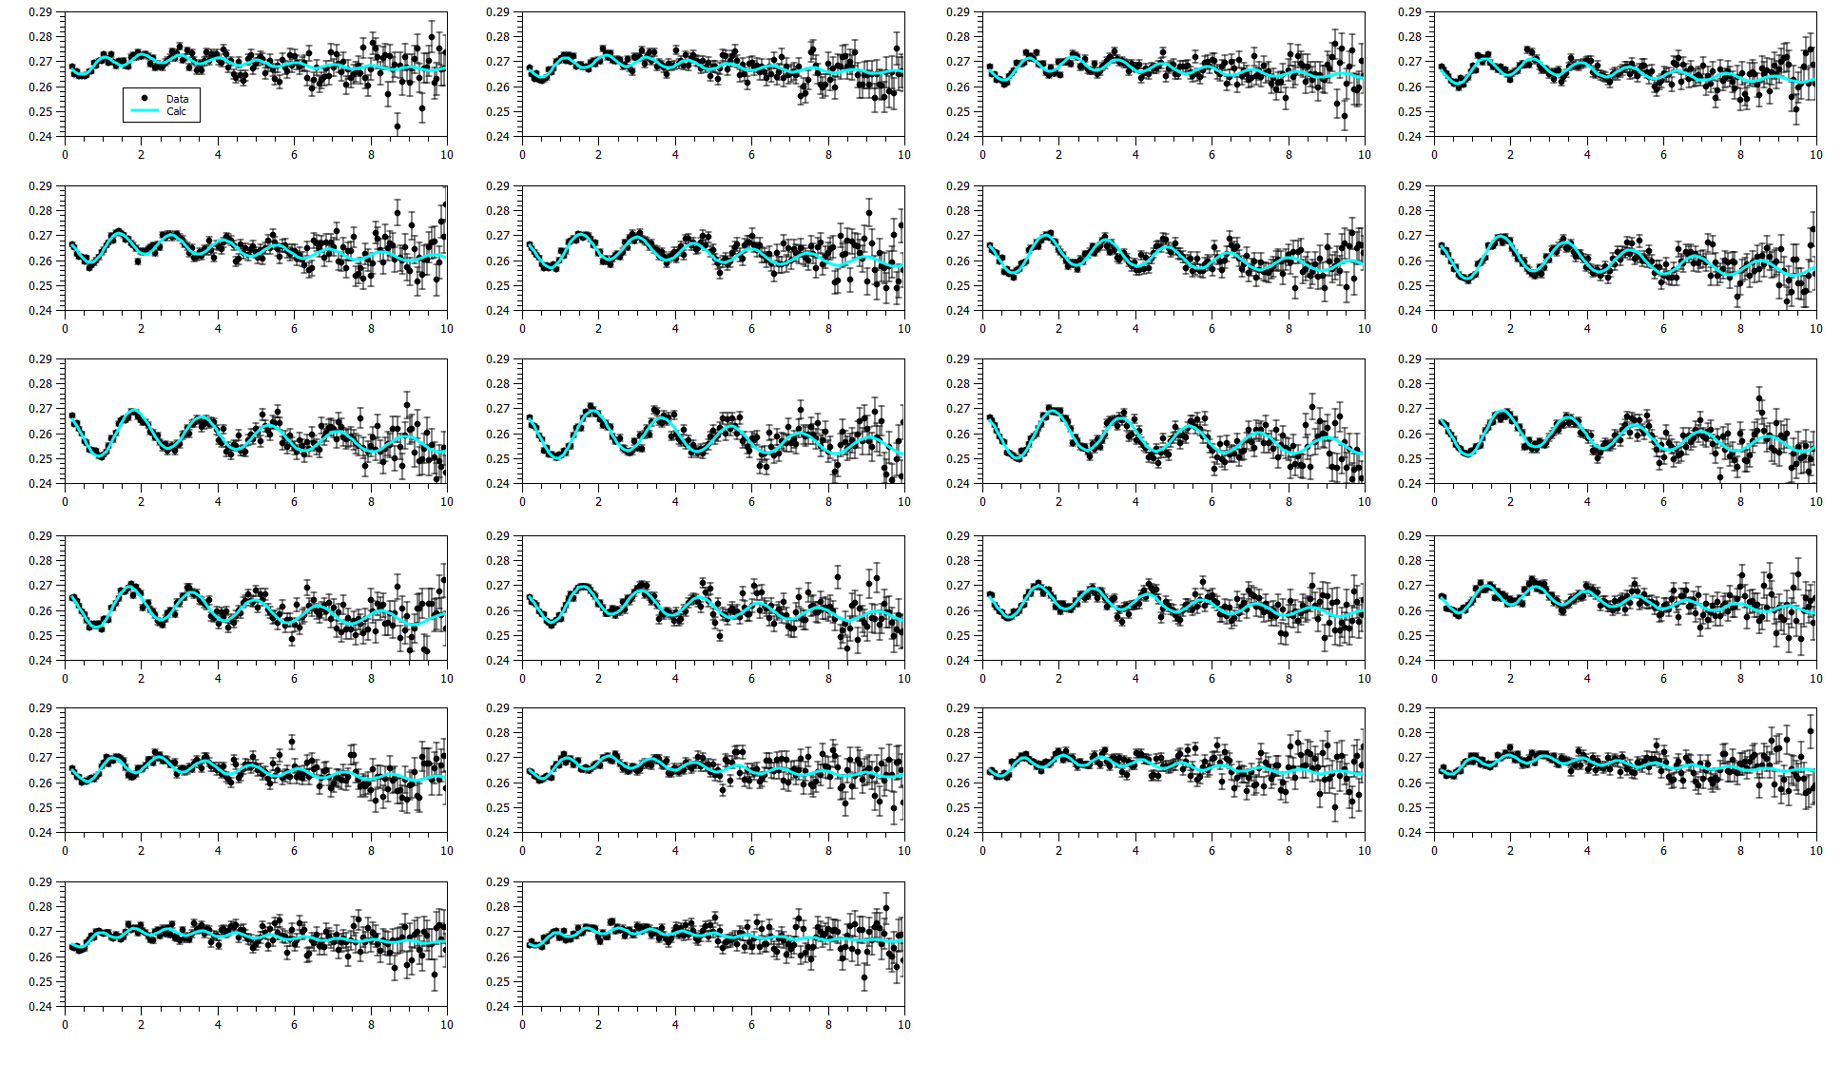
Simultaneous fits
10mM Benzene in hexane
335K, 10G field steps
352 total parameters
110 fixed, 227 tied, 15 free

Slide 13
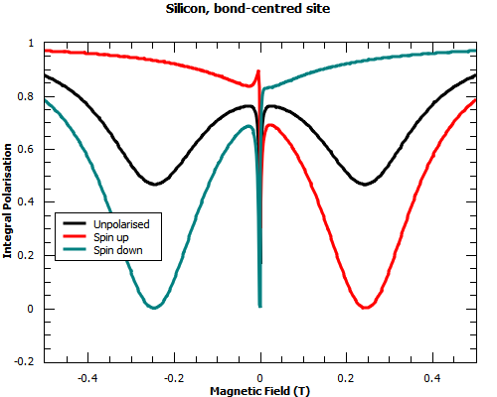
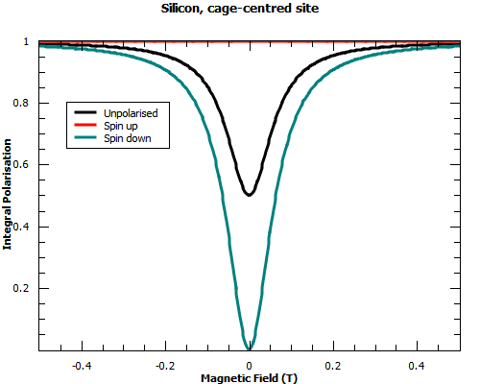
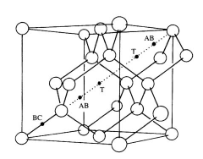
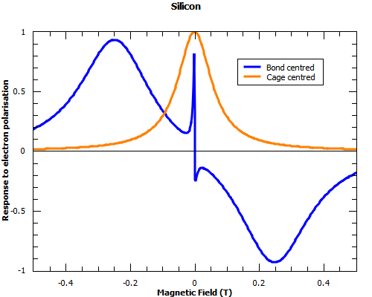
Simulations for experiment planning
Silicon, with two muon sites
Electron picked from conduction band forming muonium
Try polarising electrons with laser
What effect might we expect on the muon signal?
Which magnetic field should we use?
Run simulations in cabin with users waiting to start taking data

Slide 14
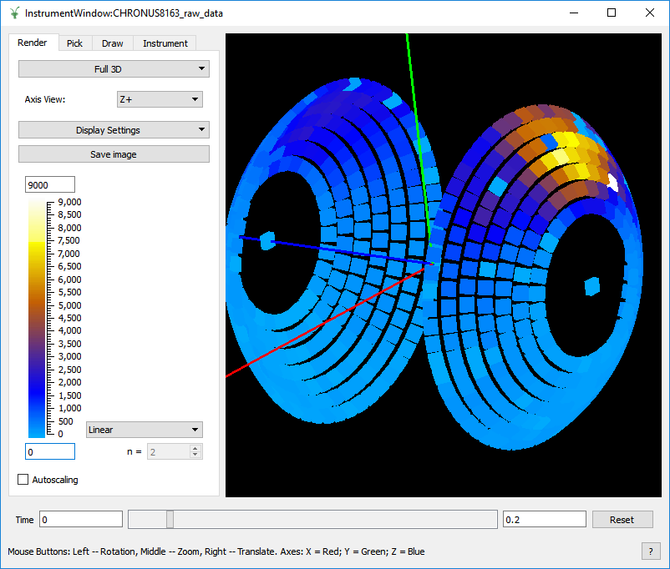
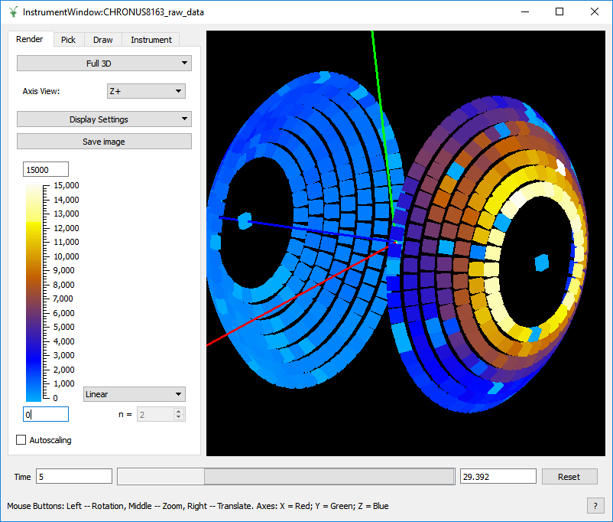
Instrument View for diagnostics
Direct plot with time slicing
Positrons from separator leaking through shielding
Muons stopping in beam pipe and collimator

Slide 15
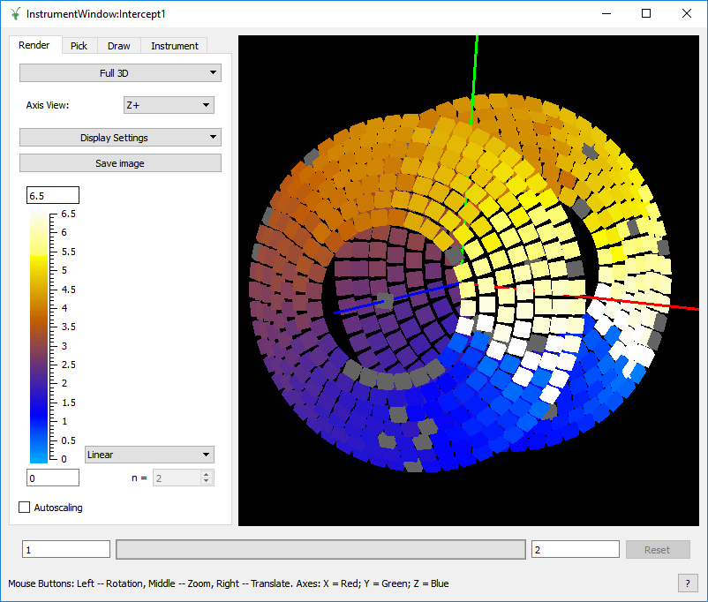
View of processed data
Script to process data
Output Workspace still has instrument definition
Phase of TF signal per detector

Slide 16
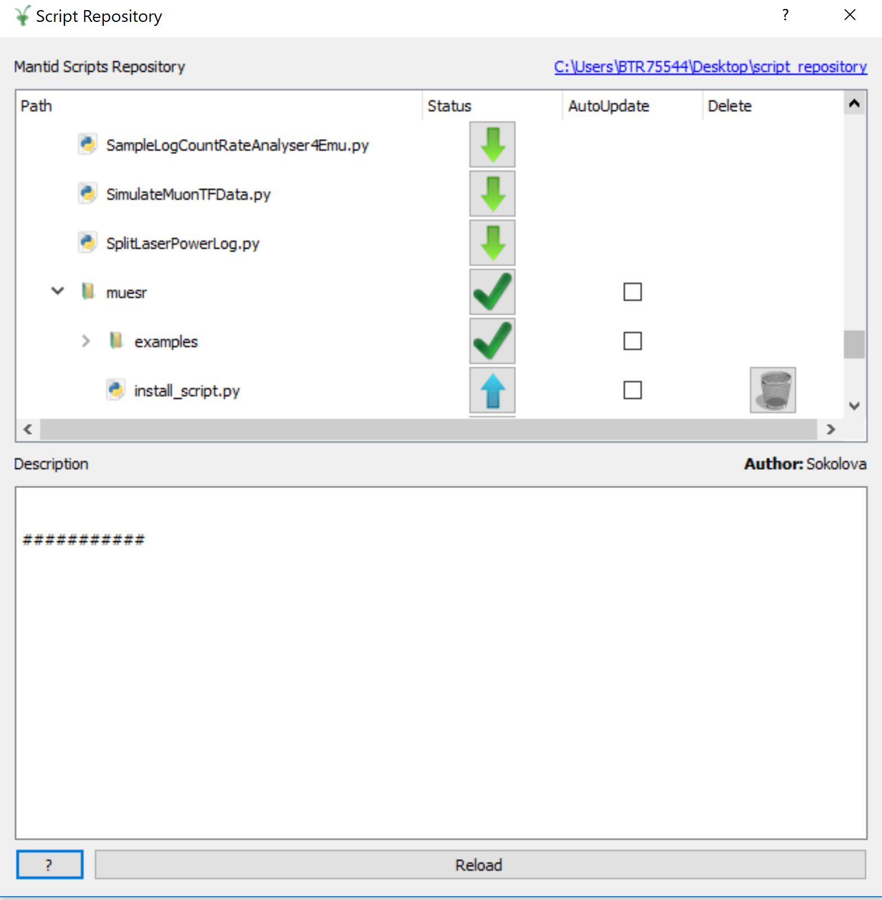
The script repository
Algorithms
Fitting functions
External packages (e.g. MuESR)

Slide 17
Advantages of the script repository
User generated scripts
Instant access for users
Can be auto-loaded into Mantid
Can reduce development time

Slide 18
Development process
Understand requirements and theory
Write code to do calculation
Verify code is correct
Write unit tests and documentation
Code review and developer testing
Made available in the nightly
Review improvements

Slide 19
Development process
Understand requirements and theory
Additional requirements or changes requested
Write code to do calculation
Verify code is correct
Tried out by scientists
Write unit tests and documentation
Code review and developer testing
Made available in the nightly
Review improvements

Slide 20
Development process
Understand requirements and theory
Write code to do calculation
Verify code is correct, with scientists
Write unit tests and documentation
Code review and developer testing
Made available in the nightly
Review improvements

Slide 21
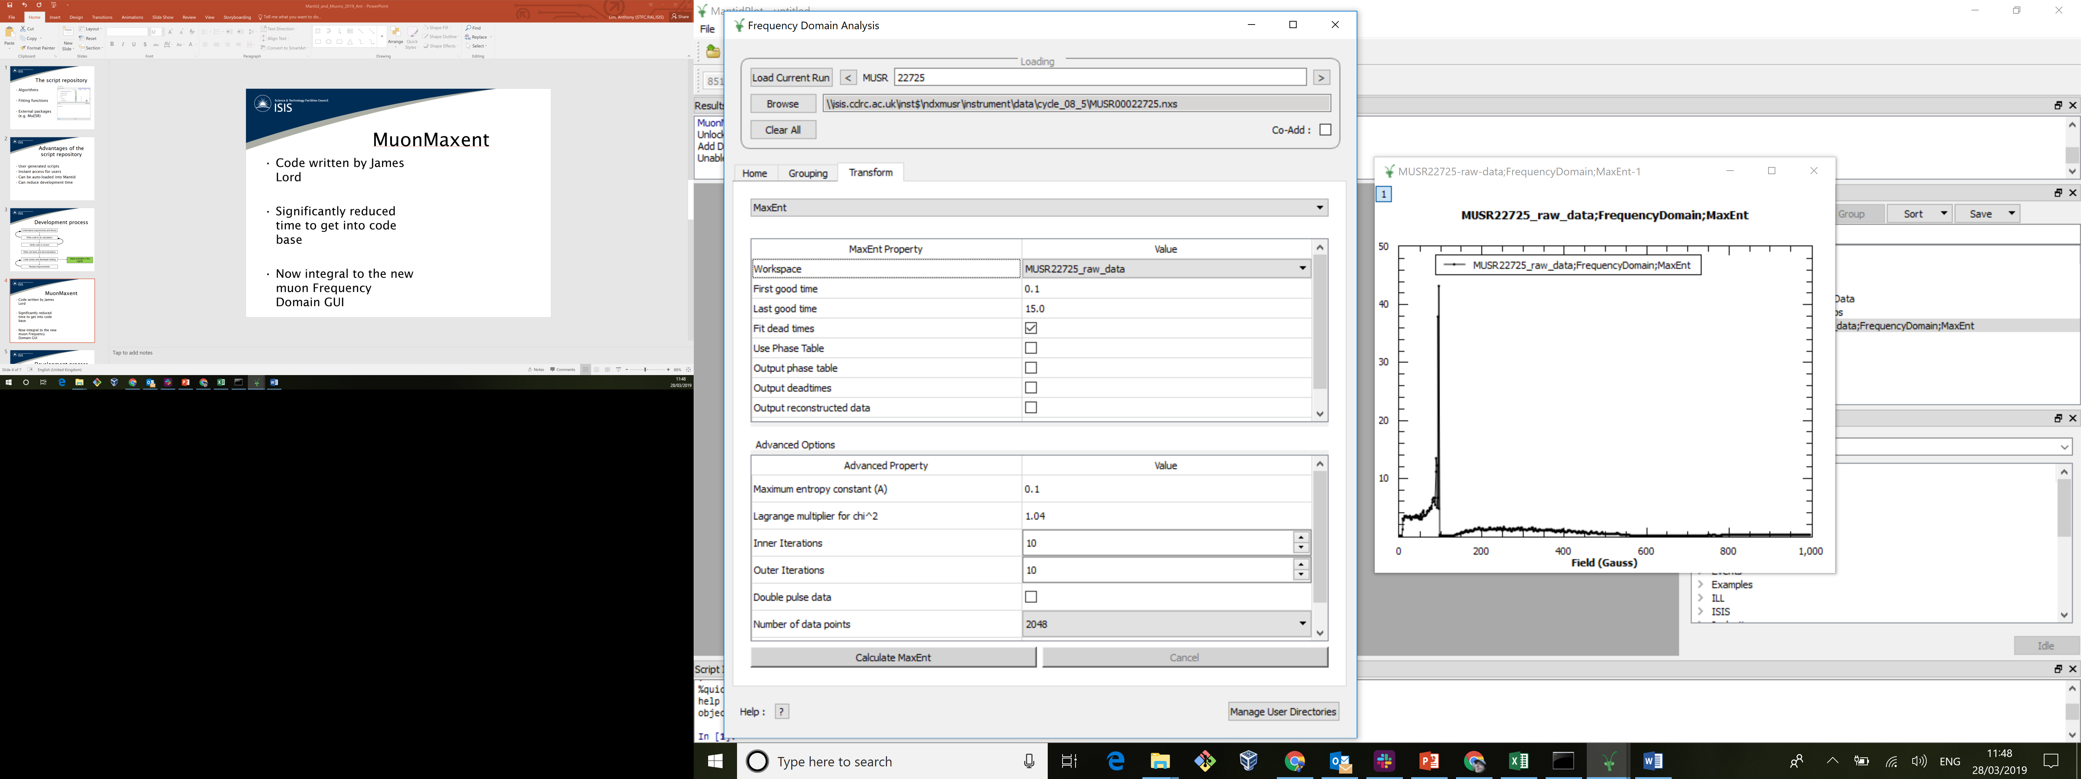
MuonMaxent
Code written by James Lord
Based on Fortran version widely used in the muon community
Significantly reduced time to get into code base
Now integral to the new muon Frequency Domain GUI

Slide 22
Development process
Understand requirements and theory
Write code to do calculation
Verify code is correct
Write unit tests and documentation
Code review and developer testing
Made available in the nightly
Review improvements

Slide 23
Development process
✔
Understand requirements and theory
✔
Write code to do calculation
✔
Verify code is correct
Write unit tests and documentation
Clean up code
Code review and developer testing
Made available in the nightly
Review improvements

Slide 24

Getting involved
Ask for code to be added to Mantid
Will cite your paper/DOI and/or give credit in the documentation

